Slide 1

Introduction to Statistics and Data Analysis: Statistics, Role of Probability, Simple random sampling

Slide 2
Application of Statistics in daily life
Statistics is the branch of mathematics which we use to analyse what is happening in the world around us. Statistics is the collection of data and its representation. Statistics compare data through mean, median and mode. We all have heard that we live in the information age where we deal about the world around us. Most of the information is determined mathematically using statistics. There are some of the examples to explain the role of statistic in real life.
1) Medical Study
Statistics are used behind all the medical study. Statistic help doctors keep track of where the baby should be in his/her mental development. Physician’s also use statistics to examine the effectiveness of treatments.
2) Weather Forecasts
Statistics are very important for observation, analysis and mathematical prediction models. Weather forecast models are built using statistics that compare prior weather conditions with current weather to forecast future weather conditions.
3) Quality Testing
A company makes thousands of products every day and make sure that they sold the best quality items. For a company it is not possible to test each product. So the company uses quality test with the help of statistics.
4) Stock Market
The stock market also uses statistical computer models for stock analysis. Stock analysts get the information about economy using statistics concepts.
5) Consumer Goods
Retailers keeps track of everything they sell and to know the stock using statistics. Worldwide leading retailers use statistics to calculate what products ship to each store and when.

Slide 3
Application of Statistics in Computer Science
Probability and statistics play a key role in real-world applications of computer science. Statistics is used for
data mining,
speech recognition,
vision and image analysis,
data compression,
artificial intelligence, and network,
the modeling of text and web data,
robotics,
network traffic and system reliability modeling,
probabilistic analysis of algorithms and graphs,
machine learning,
cryptography, and more.
A statistical background is essential for understanding algorithms and statistical properties that form the backbone of computer science.

Slide 4
Roles of Computer Scientists
Computer scientists tend to focus on
data acquisition/cleaning,
retrieval,
mining, and reporting.
They are often tasked with the development of algorithms for prediction and systems efficiency.
Focus is also placed on machine learning (an aspect of artificial intelligence), particularly for the purposes of data mining (finding patterns and associations in data for a variety of purposes, such as marketing and finance).

Slide 5
STATISTICS
Statistics is a study of data: describing properties of data (descriptive statistics) and drawing conclusions about a population based on information in a sample (inferential statistics).
The distinction between a population together with its parameters and a sample together with its statistics is a fundamental concept in inferential statistics.
Information in a sample is used to make inferences about the population from which the sample was drawn.

Slide 6
Basic Definitions and Concepts
Learning Objectives :To learn the basic definitions used in statistics and some of its key concepts.
We begin with a simple example.
There are millions of passenger automobiles in the Pakistan. What is their average value?
It is obviously impractical to attempt to solve this problem directly by assessing the value of every single car
in the country, add up all those values, then divide by the number of values, one for each car.
In practice the best we can do would be to estimate the average value.
A natural way to do so would be to randomly select some of the cars, say 200 of them, ascertain the value
of each of those cars, and find the average of those 200 values.
The set of all those millions of vehicles is called the population of interest, and the number attached to each
one, its value, is a measurement. The average value is a parameter: a number that describes a characteristic of
the population, in this case monetary worth. The set of 200 cars selected from the population is called a
sample, and the 200 numbers, the monetary values of the cars we selected, are the Sample data.
The average of the data is called a statistic: a number calculated from the sample data.
This example illustrates the meaning of the following definitions.

Slide 7
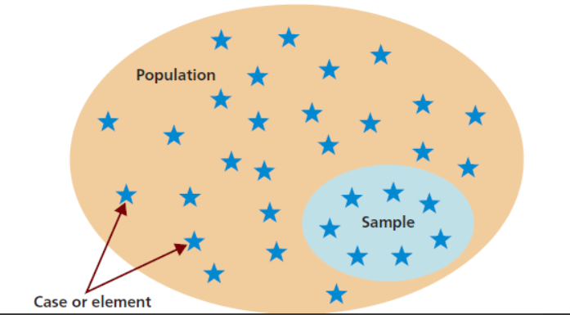
Definitions: populations and samples
A population is any specific collection of objects of interest. A sample is any subset or subcollection of the population, including the case that the sample consists of the whole population, in which case it is termed a census.
Definitions: measurements and Sample Data
A measurement is a number or attribute computed for each member of a population or of a
sample. The measurements of sample elements are collectively called the sample data
Definition: parameters
A parameter is a number that summarizes some aspect of the population as a whole. A statistic is a number computed from the sample data.

Slide 8
Continuing with our example, if the average value of the cars in our sample was $8,357, then it seems
reasonable to conclude that the average value of all cars is about $8,357.
In reasoning this way we have drawn an inference about the population based on information
obtained from the sample.
In general, statistics is a study of data: describing properties of the data, which is called
descriptive statistics, and drawing conclusions about a population of interest
from information extracted from a sample, which is called inferential statistics.
Computing the single number $8,357 to summarize the data was an operation of descriptive statistics;
using it to make a statement about the population was an operation of inferential statistics.

Slide 9
Definition: Statistics
Statistics is a collection of methods for collecting, displaying, analyzing, and drawing conclusions from data.
Definition: Descriptive statistics
Descriptive statistics is the branch of statistics that involves organizing, displaying, and describing data.
Definition: Inferential statistics
Inferential statistics is the branch of statistics that involves drawing conclusions about a population based on information contained in a sample taken from that population.
The measurement made on each element of a sample need not be numerical. In the case of automobiles, what is noted about each car could be its color, its make, its body type, and so on. Such data are categorical or qualitative, as opposed to numerical or quantitative data such as value or age. This is a general distinction.

Slide 10
Definition: Qualitative data
Qualitative data are measurements for which there is no natural numerical scale, but which consist of attributes, labels, or other non-numerical characteristics.
Definition: Quantitative data
Quantitative data are numerical measurements that arise from a natural numerical scale.

Slide 11
The Role of Probability
It is quite natural to study probability prior to studying statistical inference. Elements of probability allow us to quantify the strength or “confidence” in our conclusions. In this sense, concepts in probability form a major component that supplements statistical methods and helps us gauge the strength of the statistical inference. The discipline of probability, then, provides the transition between descriptive statistics and inferential methods.
The sample along with inferential statistics allows us to draw conclusions about the population, with inferential statistics making clear use of elements of probability

Slide 12
Sampling Procedures; Collection of Data
Simple Random Sampling
A simple random sample is a subset of a statistical population in which each member of the subset has an equal probability of being chosen. A simple random sample is meant to be an unbiased representation of a group.
Researchers can create a simple random sample using methods like lotteries or random draws.
With a lottery method, each member of the population is assigned a number, after which numbers are selected at random.

Slide 13
Simple Random vs. Stratified Random Sample
Simple random samples and stratified random samples are both statistical measurement tools.
A simple random sample is used to represent the entire data population.
A stratified random sample divides the population into smaller groups, or strata, based on shared characteristics.
Age, socioeconomic divisions, nationality, religion, educational achievements and other such classifications fall under stratified random sampling.

